Slide 1
Bible Trivia
Who served as Peter’s amanuensis?
Silvanus

Slide 2
Bible Trivia
What is the name for God, Hashem, mean?

Slide 3
LIVE SENT
FBCA MISSION STUDIES
LESSON 1: Reaching Unreached People Groups from the Inside
Author: Cindy Wiles
Text: John 4:1-42
SUMMARY: Jesus “crossed cultures” and engaged a Samaritan woman on “her turf” with the Good News. As a result, many people in that town believed in Him because of her testimony.

Slide 4
LESSON 2: Joining Christ in Crossing Cultures
Author: Peggy Kulesz
Text: Acts 11:1-25; Acts 13:1-3; Acts 16: 6-10
SUMMARY: We must let go of our personal prejudices and preconceived notions – and experience discomfort, sacrifice, and inconvenience – to be used by God in advancing His worldwide plan of redemption.

Slide 5
LESSON 3 – Joining Christ Among the Diaspora
Author: Rebecca Dark
Text: Acts 2:1-41
SUMMARY: God is always at work orchestrating world events- often in counterintuitive ways – to accomplish His diving purposes. The Kingdom of God is multi-lingual, multi-ethnic, and not yet, eternal empowered by the Holy Spirit, and is all about Jesus.

Slide 6
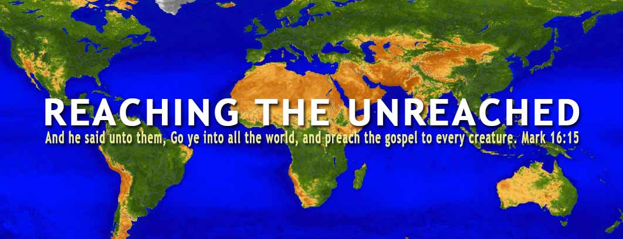
Reaching the Unreached Peoples from the Inside
John 4:1-42
Lesson 1
Writer: Cindy Wiles

Slide 7
KEY MISSIONAL CONCEPTS
Unreached People Groups (UPG) – A group of people distinguished by a distinct culture, language, or social class who lack an able community of Christians within to evangelize the rest of the people group without outside help. (Less than 2% Christians present within the population)

Slide 8
People Groups in the World
According to the Joshua Project (Christian Research Team) there are approximately 17,466 people groups in the world.
Over 7,400 are unreached people groups with 85% living in the 10-40 window. Less than 10% missionary work is done among these peoples.

Slide 9
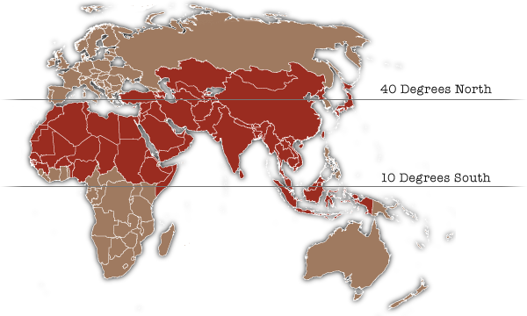
What is the 10-40 window?

Slide 10
Insider Witness – A Christian member of an Unreached People Group who utilizes their commonality of identity, language, culture, community, religious understanding and natural access to bear witness of Christ within their native culture regardless of location.

Slide 11
Gospel Bridges – Connections and commonalities between the worldview of the Gospel witness and those receiving a Gospel witness that enhance relationship and increase understanding of Gospel truths.

Slide 12
Barriers to Spreading the Gospel
Geographical
Cultural
Political
Religious
Social

Slide 13
Mission Facts
3.23 billion people out of 7.75 billion are in the unreached people groups. (1 out of 3 do not know Jesus or have little or no access to the Gospel.)
In 2004 FBCA adopted our first UPG, the Fulani people group, as the focus of our mission efforts.

Slide 14
FBCA now supports and partners with witness of Christ among 13 people groups.
FBCA utilizes insider witnesses to take the Good News of love to unreached peoples in ways they can hear and understand.

Slide 15
John 4:1-42 is the story of how Jesus used an insider witness to lead an antagonistic community to embrace the Good News.

Slide 16
John 4:1-9
Now Jesus learned that the Pharisees had heard that he was gaining and baptizing more disciples than John— although in fact it was not Jesus who baptized, but his disciples. So, he left Judea and went back once more to Galilee. Now he had to go through Samaria. So, he came to a town in Samaria called Sychar, near the plot of ground Jacob had given to his son Joseph. Jacob’s well was there, and Jesus, tired as he was from the journey, sat down by the well. It was about noon. When a Samaritan woman came to draw water, Jesus said to her, “Will you give me a drink?” (His disciples had gone into the town to buy food.) The Samaritan woman said to him, “You are a Jew and I am a Samaritan woman. How can you ask me for a drink?” (For Jews do not associate with Samaritans.)

Slide 17
What were the barriers Jesus removed in His conversation with this person?

Slide 18
What were the Gospel Bridges Jesus used in conversing with this woman? (4:10-26)
Wells and Water
Common Heritage
Messianic Expectation

Slide 19
Was Jesus’ journey to the well meant for the salvation of this one woman?
or
Was Jesus’ intention to open the door of salvation to the entire Samaritan community?

Slide 20
CASE STUDY
The Farsi People Group

Slide 21
What Can We Learn from this study?
God often uses “insiders” to reach people who are resistant to the outside Gospel witness
Identifying “Gospel bridges” for share the Good News is an effective means of witness.

Slide 22
What Can We Do?
Pray for the UPG, for the insider witness
Give to continue the ministry to the UPG.
Go to minister in person
Welcome internationals

